Slide 1


Team Leadership Workshop
Uladzimir Litvinau
Java Mentoring Program D3-D4
2021

Slide 2

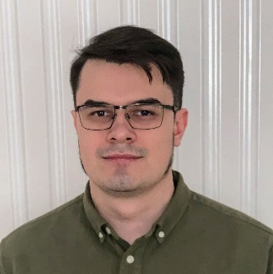

JOB POSITION / PROJECT ROLE
Software Engineering Team Leader
Team Lead and Head of BE Guild
on WALG CORE project
Primary Skill: Java
Secondary skill: Leading
Previous experience: Head of Java department

Slide 3
AGENDA
Team Leader
DEFINITION AND RESPONSIBILITIES
Theory and practice
SCIENTIFIC APPROACH
12 Use-Cases
OF TEAM DEVELOPMENT – FROM THE BEGINING
TILL THE END

Slide 4

Rules
No multitasking
Be active (teamlead should have and be able to express his opinion)
This knowledge will be useful and for leads and for team members
Formulate your statements correctly - do not forget about the characteristic of measure

Slide 5
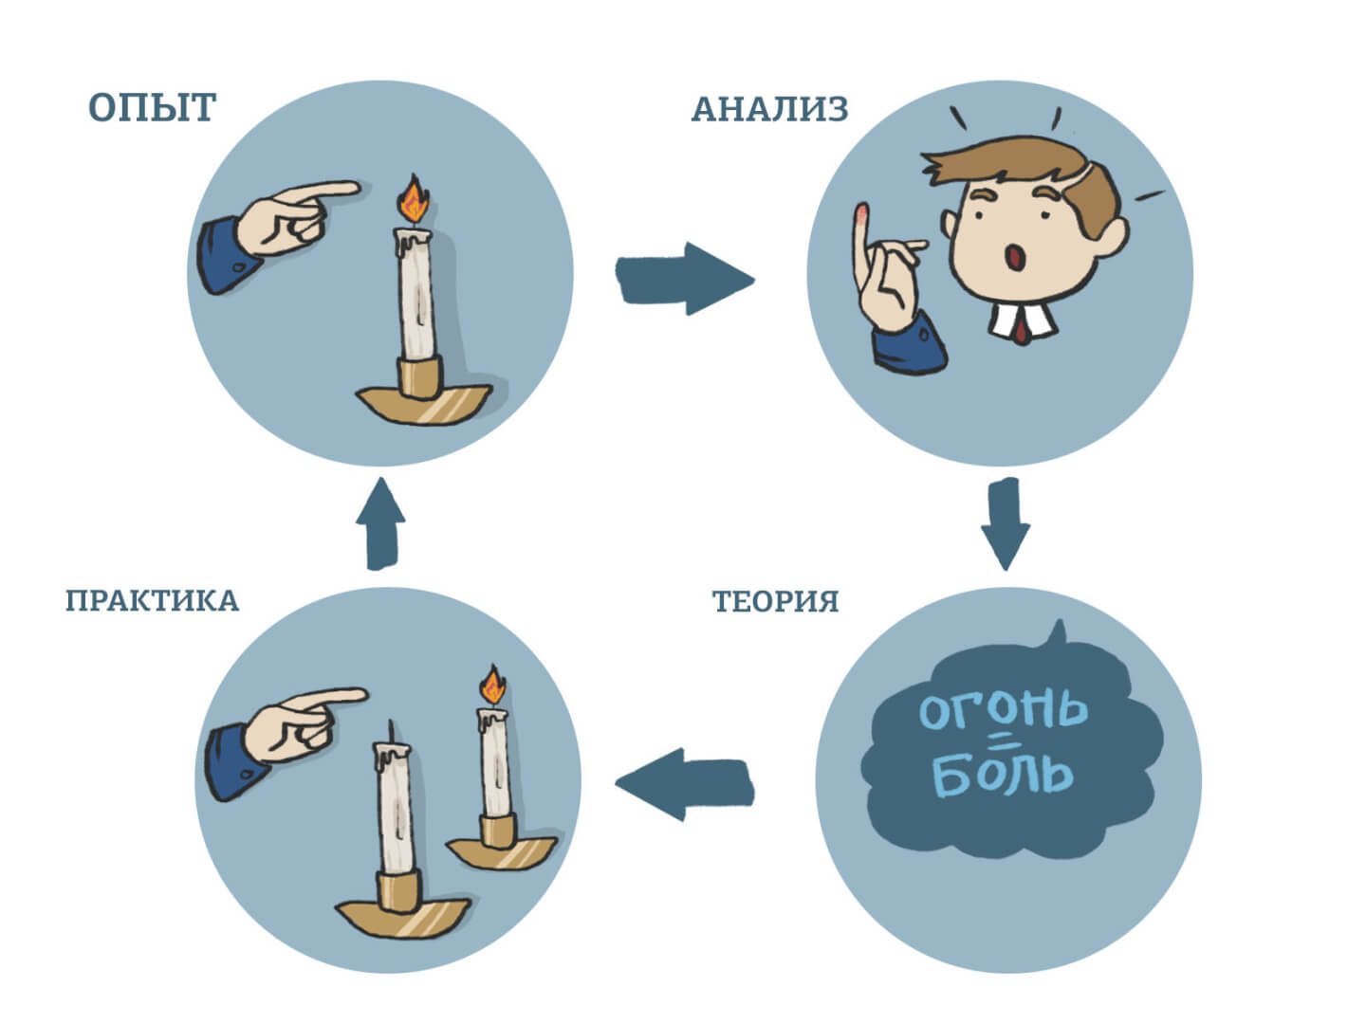
Kolb's Experiential Learning Theory

Slide 6
Key skills
?

Slide 7
Definition of team
A team is a small number of people with complementary skills who are committed to a common purpose, set of performance goals, and approach for which they hold themselves mutually accountable.

Slide 8
Common skills – what does it mean?
Read (how to read)
Listen
Analyze and synthesize (formal logic)
Discuss (art of discussion)
Learn
Teach
Solve
Lead

Slide 9
Key skills
Personal skills:
- communication
- management styles
- relationship
- self education
- thinking
- time management
Roles and responsibilities:
- administrator
- integrator
- people manager
- product owner
- technical lead

Slide 10
Key skills
- team development
- estimations
- agile
- feedback
- knowledge sharing
- facilitation
- teaching

Slide 11
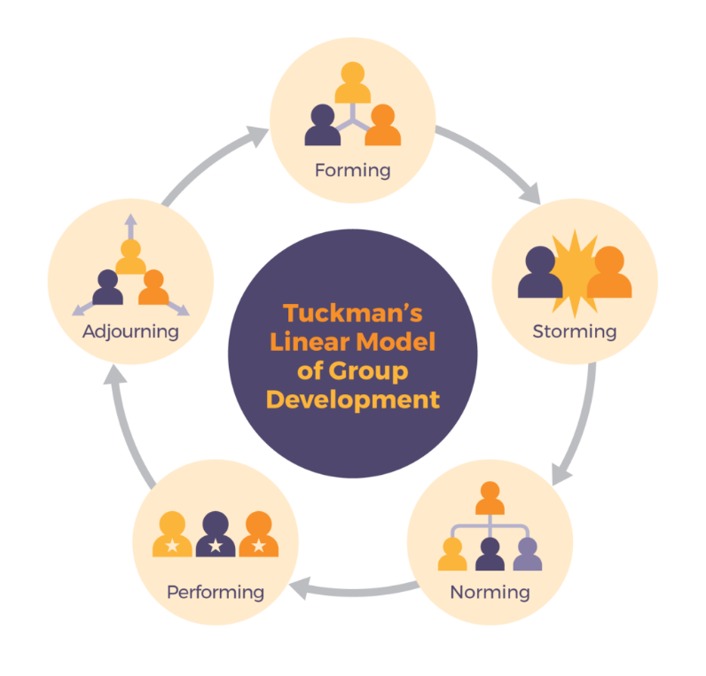
Team development model by Tackman

Slide 12
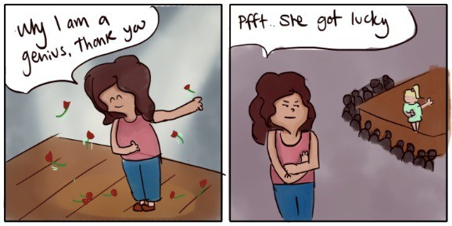
THE FUNDAMENTAL ATTRIBUTION ERROR

Slide 13
Try to look at every situation in 3 types of perspective (Dialectics method):
from many sides and point of views in the current moment
in development - how did we come to this situation and what will be effects in future
in collision - how does this situation affects other workers and processes

Slide 14
So, you've just become a team lead of new team that will work on new project…
Team:
Adam - key developer with a huge experience, more interested in technical staff
Bob - strong middle developer with specific experience, which is required for this project - also he very likes his previous team and its lead, and he doesn't believe that this one can be half as good as previous
Eva - junior superstar developer, like to learn - interested in everything
Diana - tester, wants to grow in test automation
Mary - PO + business analytic from client's side, owns most of the communications with the customer
Dean - scrum master, he is good at setting up of standard ceremonies, but don't expect something more from him
Pavel - DevOps, trying to make fully automated CI / CD on the project

Slide 15

Case 1: New beginning
for Team Leader
You've just met your new team.
What will be your first actions?

Slide 16
Case 2: Chose
for Team Leader
In your work you need two frameworks, first is required from client's side. Second you and your team should choose.
How will you do it?

Slide 17
Case 3.1: Estimation
for Team Leader
Client asks you to estimate first epic with the list of stories.
How will you do it, what instruments and practices will you use for it?

Slide 18
Case 3.2: Estimation
for Team Leader
After estimation session Eva said that she doesn't understand how estimation works, for her is obvious, that she'll do same task as Adam for x100 times longer.
What will you do with it?

Slide 19
Case 3.3: Estimation
for Team Leader
PO thinks that your estimation is too big she thought that it will take less time or story points. What will you do?

Slide 20
Case 4: First conflicts
for Team Leader
You and all the rest team can see that something bad going on between Adam and Bob, on the first weeks they were trying just ignore their differences, but now you all can see that every daily, estimation or even discussion on any question leads to conflicts.
What will you do?

Slide 21
Case 5.1: Tests and testers
for Team Leader
Diana complains that after implementing of every feature something is breaking in features that was implemented before, she asks you to do something with it.
What will be your actions?

Slide 22
Case 5.2: Tests and testers
for Team Leader
Whatever decision you make, in few weeks after, you can see that Bob is ignoring your decision and Eva is taking he's behavior as an example. What will be your actions?

Slide 23
Case 6.1: Bottleneck and bus factor
for Team Leader
Bob starts to be a bottleneck - he's capacity isn't enough to solve all required issues.
How can you solve it?

Slide 24
Case 6.2: Bottleneck and bus factor
for Team Leader
After 6 moth from start of project Bob broke his arm, and he will not be able to work for 3 weeks. Are you ready for this situation? What should you do if you are ready, and what if you are not?

Slide 25
Case 7: Breaking of sprint
for Team Leader
Client asks your team to add ultrahigh priority task in the middle of current sprint. Adam doesn't think that this is a good idea, Mary thinks that we just must do it anyway.
What will you do and how will you convince your position or decision?

Slide 26
Case 8: Effort and impact
for Team Leader
User story contains several tasks, one of which has tiny functionality but at the same time require large efforts.
How will you communicate it with PO / customer?

Slide 27
Case 9: Unclear requirements
for Team Leader
Business Analyst create contradiction requirements unclear for developers.
What will be your actions?

Slide 28
Case 10: Team lead
for Team Leader
Developer from your team want to lead your team for you (who is it depending on your previous decisions).
What will you do?

Slide 29
Case 11: Demo
for Team Leader
When 10 minutes prior to demo for customer you spotted that application / functionality you need to demonstrate does not work.
What will be your actions?

Slide 30
Case 12: The end
for Team Leader
You did a very good job, customer is happy, team very like you and each other, team spirit is very-very high. But you know, that soon project will be over, the job is done.
What should you think about it and what should you do?

Slide 31

#TEAM LEADER WORKSHOP
by Uladzimir Litvinau
THANK YOU FOR ATTENTION

